Slide 1
Problem Solving Using Computers

Slide 2
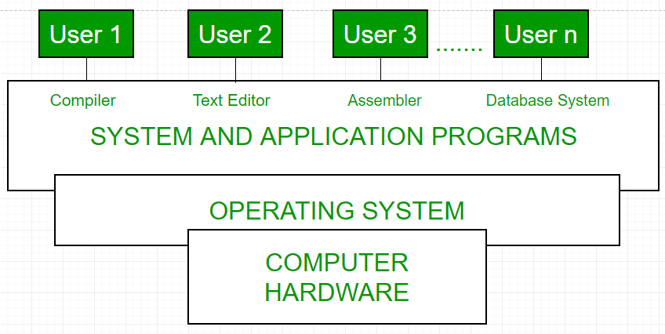
Programming Introduction
It is a program to operate computer hardware .
Unix —Most powerful OS
Windows—Most popular
OS programming language: c\c++

Slide 3
Programming Introduction
What is Program:
Program—Set of instructions-> M/c code
English statements → Compiler →M/c
(High level language)
English statements → interpreter →M/c
(High level language)

Slide 4
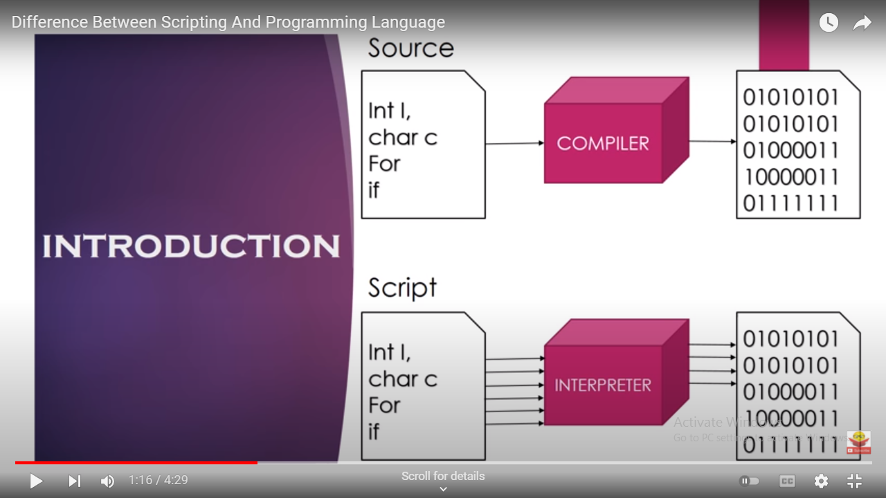
Programming Introduction

Slide 5
Major Evolution of programming language
Machine languages:
first programming languages,
It consisted of binary code that was directly executed by the computer's hardware.

Slide 6
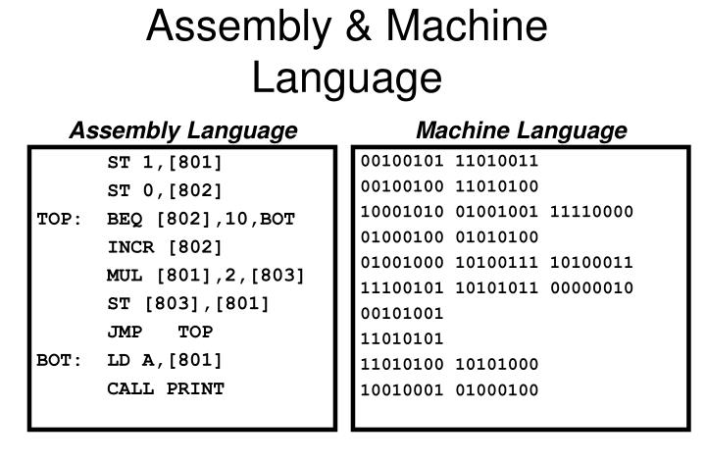

Slide 7
Due to its complexity
lack of readability
Higher-level programming languages were later developed to make coding more accessible and efficient.

Slide 8
Assembly Language
Second-generation programming languages
More human-readable alternative to machine language
Mnemonic codes and symbols instead of binary

Slide 9
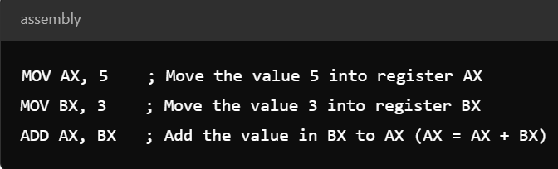

Slide 10
Key features of assembly language:
Mnemonics: symbolic names like MOV, ADD, SUB, correspond to specific machine code
Instructions Registers: Assembly languages operate closely with a computer's hardware registers (small storage locations inside the CPU).
Assembler: A special program called an assembler is used to convert assembly language code into machine language (binary) that the hardware can execute.

Slide 11
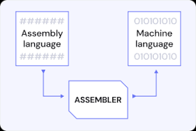

Slide 12
Assembler
Purpose: Converts assembly language code into machine code (binary) that can be executed by the computer's CPU.
Input: Assembly language (low-level code close to machine instructions).
Output: Machine code.
Execution Speed: Very fast, as assembly is a low-level language and directly translates to machine instructions.
Example: NASM (Netwide Assembler), MASM (Microsoft Macro Assembler)

Slide 13
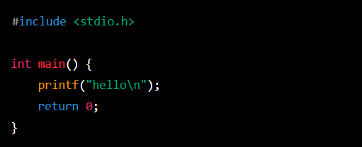
High-Level Languages:
These languages used English-like syntax.
Easier for humans to read and write.
Examples include COBOL, FORTRAN, and LISP, c.

Slide 14
Compiler/Interpreter:
High-level language code is not executed directly by the CPU. Instead, it is either compiled (e.g., C, C++).
Interpreted (e.g., Python, JavaScript) into machine code that the computer can execute.

Slide 15
Characteristics of High-Level Languages:
Readability: English statement makes code easier to read and write.
Portability Code written in these languages can run on different hardware architectures with minimal modification.
3. Ease of Use: memory management, error handling, and built-in libraries, making them easier to use than lower-level languages.

Slide 16
Compiler
Purpose: Translates high-level programming languages (e.g., C++, Java) into machine code or an intermediate bytecode, which can be executed by the machine or a virtual machine.
Input: High-level language (e.g., C, C++, Java).
Output: Machine code (native code) or intermediate code (e.g., bytecode in Java).
Execution: Converts the entire program into machine code before execution.
Execution Speed: Program runs faster as it's fully translated into machine code before execution.
Example: GCC (GNU Compiler Collection), javac (Java Compiler).

Slide 17
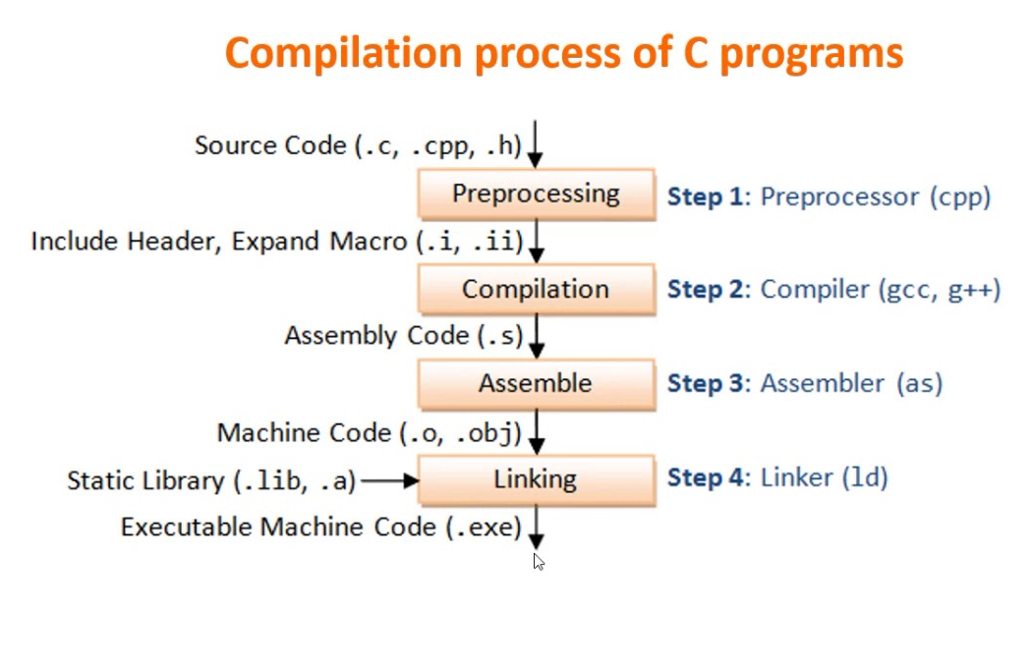

Slide 18
Interpreter
Purpose: Directly executes high-level language code line-by-line without translating it into machine code in one go.
Input: High-level language (e.g., Python, JavaScript).
Output: No direct machine code output. Executes the program directly.
Execution: Interprets and runs code line-by-line, so no intermediate or machine code is generated.
Execution Speed: Generally slower than compiled programs because each line is translated and executed at runtime.
Example: Python Interpreter, Node.js (for JavaScript).

Slide 19
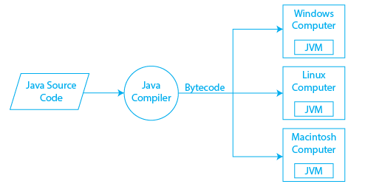

Slide 20
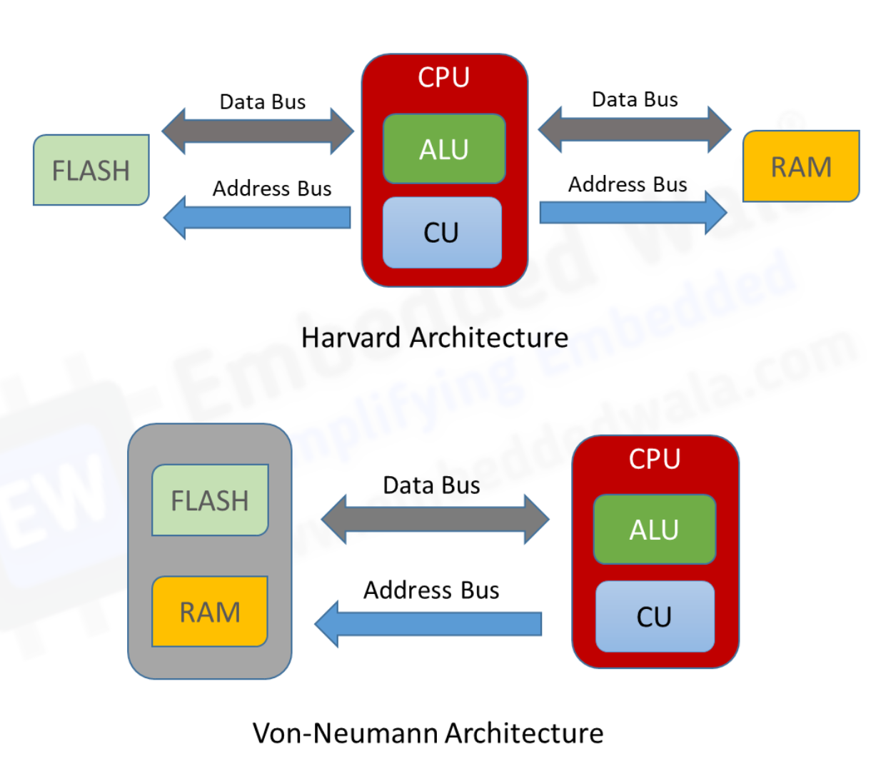

Slide 21
Von Neumann Architecture
Overview: The most common and traditional computer architecture. It is based on the concept of a single memory space that stores both instructions and data.
Key Components:
Central Processing Unit (CPU): Executes instructions.
Memory: Stores both the program (instructions) and the data.
Input/Output Devices (I/O): Interfaces for communication between the computer and external devices.
Bus System: Connects the CPU, memory, and I/O devices.

Slide 22
Control Unit (CU):
Function: Manages and coordinates the operations of the computer. It interprets instructions from the program, directs the flow of data between different parts of the CPU, and controls the execution of instructions.
Arithmetic Logic Unit (ALU):
Performs arithmetic (addition, subtraction, etc.) and logical operations (AND, OR, NOT, comparisons).

Slide 23
Register : Small, fast memory locations inside the CPU that store temporary data and instructions that are being processed.
Types:
Accumulator: Stores intermediate results of operations.
Program Counter (PC): Keeps track of the memory address of the next instruction to be executed.
Instruction Register (IR): Holds the current instruction being executed.
Status Register: Stores flags (e.g., carry, zero, overflow) that indicate the status of the ALU after an operation.

Slide 24
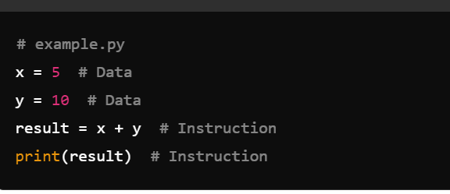

Slide 25
Characteristics:
Instructions and data are fetched sequentially, one at a time.
Bottleneck: The single bus for both instructions and data can lead to performance bottlenecks, known as the Von Neumann bottleneck.
Example: Most general-purpose computers, including personal computers

Slide 26
Characteristics of Harvard Architecture
Instructions and data can be fetched in parallel, improving performance.
Commonly used in embedded systems and microcontrollers.
Example: ARM microcontrollers, DSP processors.

Slide 27
PARAMETERS | COMPILER | INTERPRETER | ASSEMBLER
Conversion | It converts the high-level programming into Machine language. | It also converts the High-level Instruction (Byte Code) into machine language | It converts programs written in the assembly language to the machine language or binary code.
Scanning | It scans the entire program before converting it into binary code. | It translates the program line by line to the equivalent machine code. | It converts the source code into the object code then converts it into the machine code.
Error Detection | Gives the full error report after the whole scan. | Detects error line by line. And stops scanning until the error in the previous line is solved. | It detects errors in the first phase, after fixation the second phase starts.
Code generation | Intermediate code generation is done in the case of Compiler. | There is no intermediate code generation. | There is an intermediate object code generation.
Examples | C, C#, Java, C++ | Python, Perl, VB, PostScript, LISP, etc… | GAS, GNU

